Slide 1


Presented By : Ashwini Sonawane
SEO Work Progress

Slide 2
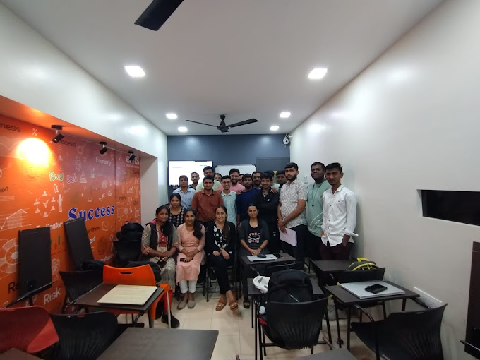
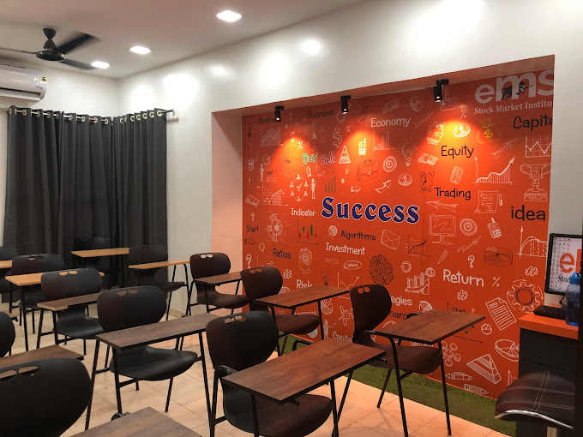
About EMS Share Market Classes
Since 2011, eMS Share Market Classes in pune provides complete stock market education in Pune. eMS share market courses, covers fundamental & technical analysis along with live practicals to enhance students with trading skills. eMS share market coaching institute offer lifetime support, eMS provide online share market classes in pune. ems is top stock market institute which deliver Profitable Strategies with back-testing reports.

Slide 3
Client Requirement
Key Points
1. Keyword Ranking – Improve Keywords on Top 5th Position
2. Improvement in Organic Traffic
3. Valid Leads – Via Organic Channel , GMB
4. GMB Posting
5. Google Review

Slide 4
Initial Analysis
Initial Analysis
Website Audit Highlights:
Before Start the SEO :
All Keywords are Target on Homepage
Missing on-page SEO – Meta Title, Header Structure , Meta Description, Content , Keywords are not optimize.
UI/UX & On Page Suggestions
Visuals: Add high-quality, relevant images or illustrations to break up text-heavy sections and make the content more engaging.
The contact form pop-up is loading before website loading, As per UX laws user pop-up
Should be shown after a half website scroll.
Font size and spacing should be consistent
Too much animation for on Website For every Icon. It Distracts user attention from key points.
Blog section should be redesign.

Slide 5
Initial Analysis
Initial Analysis
Our Team Section is Important in about us Section, So design should be attractive.
Also the drop down is opening upward For Course.
Need more CTA
FAQ Section Missing
Table of Content Not Add in Blogs
Blog Folder Missing
Current URL is - https://sharemarketclasses.in/how-to-select-proper-stock-market-training-institute/
URL - https://sharemarketclasses.in/blog/how-to-select-proper-stock-market-training-institute/
Create Thank You Page
Schema’s Missing
Create the Course wise Pages

Slide 6
Off page Optimization
Use High Quality Backlinks – Most of the Focus on Content Related Activity – Web 2.0, Article Submission, Blog Posting
Using the Good DA Submission Sites
GMB Posting Along with Keywords In Hash tag
Calendar – https://docs.google.com/spreadsheets/d/1W0yJOsy46p63wOT2gVr3uqr6xANKnlst/edit?gid=1974542408#gid=1974542408
Publish Google reviews – Optimized Keywords
Major Focus on Quora Q & A
Promoting the Website Blogs in Content related Activity – Write some pitch added the internal linking.
Use the High impression and clicks blogs For promotions, Also Suggest the Keywords as shown in GSC.

Slide 7
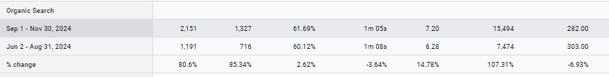
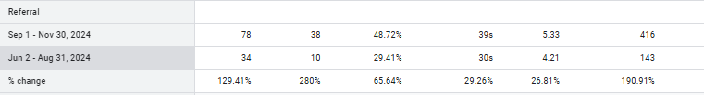
Organic Traffic Overview
We Can See the improvement in Organic Traffic - Increased by 80.6% is As compared to Last 3 months
Also See the Improvement in Referring Traffic As well

Slide 8
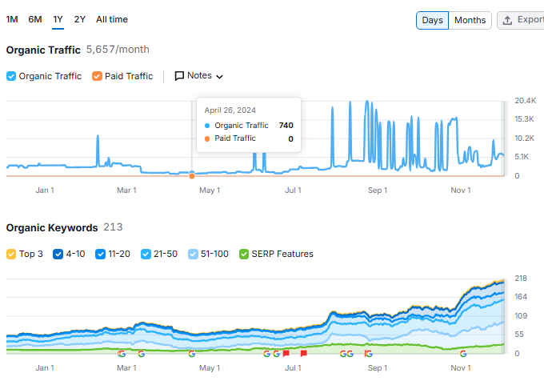
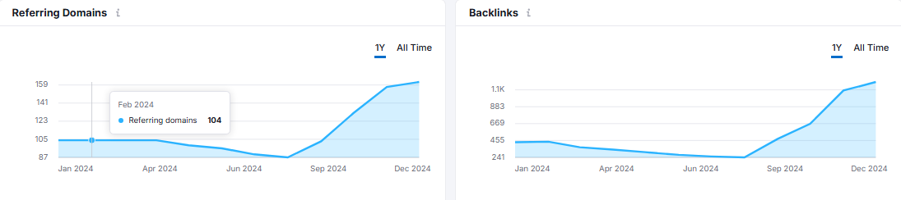
Semrush Overview
Organic traffic, Organic Keywords Are Improved.
Referring Domains and Backlink Count Improved Monthly

Slide 9
Keyword Ranking Performance
Sr No | Keyword | Initial Ranking (31 Aug 24) | 02 Dec 2024
1 | share market classes in pune | 14 | 6
2 | Share Market Courses In Pune | 32 | 7
3 | best share market courses in pune | 21 | 4
4 | share market classes | 20 | 1
5 | Best Share Market Classes In Pune | 16 | 6
6 | share market classes near me with fees | 12 | 5
7 | share market course near me | 11 | 6
8 | share market classes near me | 11 | 4
9 | stock market classes in pune | 19 | 5
10 | stock market institute in pune | Not in 100 | 6
11 | stock market classes | 31 | 2
12 | stock market classes near me | 16 | 4
13 | stock trading classes in pune | 17 | 8
14 | trading classes near me | 19 | 7
15 | best share trading classes in pune | 20 | 12
16 | Best online share market classes near me | Not in 100 | 3
17 | Intraday trading classes in pune | Not in 100 | 5
18 | Top share market classes in pune | Not in 100 | 5
19 | Top 10 Best Online Share market courses | Not in 100 | 5
20 | Future and Option Trading Classes in Pune | Not in 100 | 9
1st Page Keywords – 19
Top 5th Position Keywords - 10

Slide 10
THANK
YOU

